Slide 1
Multifaceted
Hyperlinked
Imagery
Tying Together Visual Media
With Matthew “Cookie” Davis

Slide 2

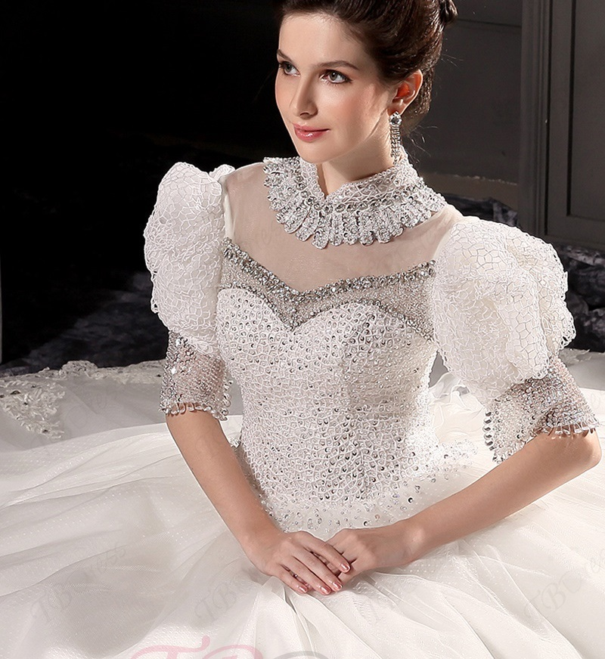
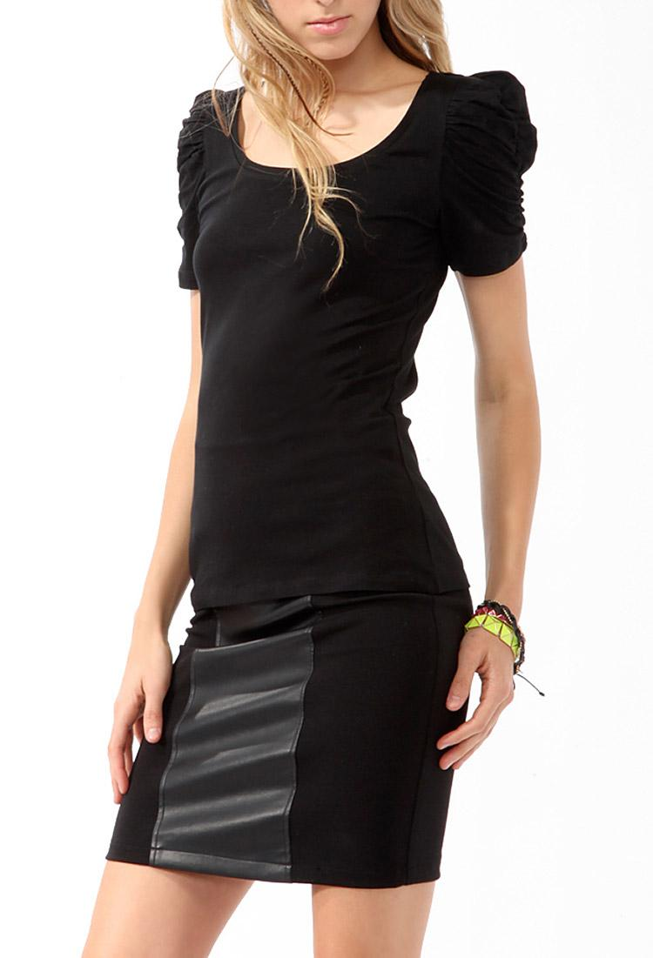
Pictorial Relations and Image Retrieval
Notes:
The ‘problem’ of multifaceted hyperimages is one primarily of recognition, organization, and retrieval, one that is particularly prevalent in fields that function heavily off of imagery. To better explain the problem requires to better explain the terminology. A multifacted hyperimage is an image that has the ability for arbitrary regions to be highlighted, given a label or category (a facet), and then linked to images of the same category through hyperlinking. This allows for any spot on an image, small as a pixel or large as the image, to become linked to all images that share the tag of that region. Doing so offers quick retreval and quick organization of all related images as dictated by a user, or potentially by a trained AI.

Slide 3
Reference (and growing)
R. Singh, C. Massa and P. -. Corlobe, "Multifaceted Hyperimage-Based Organization and Interaction with Bio-Medical Images," Twentieth IEEE International Symposium on Computer-Based Medical Systems (CBMS'07), Maribor, 2007, pp. 153-158, doi: 10.1109/CBMS.2007.74. Venkatagiri, Seshadri, Chan, Mun, and Ooi, Wei. "Automated Link Generation for Sensor-Enriched Smartphone Images." ACM Transactions on Multimedia Computing, Communications, and Applications (TOMM) 12.1s (2015): 1-25. Web.
Notes:
My current references for study are as such. The study done by Singh, Massa, and Corlobe is as offered in the project guide. It refers primarily to the problem and seems to have an almost unique look at it. Their study involved the use of hospital imagery to tag specific parts of images to correlate the visuals and associated data of treatments and injuries together. Primarily, they used a stock image of a human body to represent a patient, then tagged specific body parts with injuries and treatments, then connect the images of these to images of other patients with injuries and treatments of the same nature on the same body part. The program they demoed for this offers insight into how to structure this data and how it can be used, and has led to me to think about potential ways to enhance this for broader or more average use.
The second reference is one such broader use case, though it is very different. In their study, they developed an app called Autolink that took not only images, but other sensor data from smartphones to connect and link photos of events that would otherwise be hard to match. As they described, concerts in particular with images from different angles under different light conditions, are hard to connect to one another and can have wildly varying quality. Their app Autolink, which managed to cluster images with 70% precision and 37% better recall than candidate algorithms, used the images and the sensor data to put them together so that users could look at the same event from different angles and find images of better quality. While this does not offer the same usability as I am looking to research, it does share insight into hierarchal structures and other hyperimage applications.

Slide 4
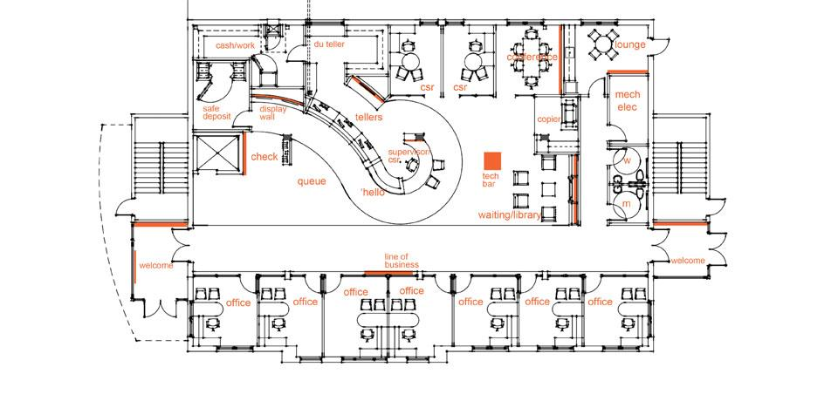
The Plan
Setting Up The Heist
Further Research
Data Structures
Database System
Facet Structures
Image Manipulation
Image Linking
Image Retrieval
Multi-Facet Searching
Auto Linkage
Future Developments
Notes:
Putting together the needed development for this project will still require some research, especially for the manipulation and storage of images. While image analysis is not strictly required, some research into it will be for future developments. The big things to consider are, the data hierarchy for structuring facets and the database, how to insert images into a database such that they can be tagged, linked, and retrieved, how to select and track regions in images, how to track and add new categories and labels, and how to apply multiple facets to a single database retrieval to limit returns.
The first resource from before talks heavily about the use of an XML databse and an XML data structure that was a part of the image header itself, which stored the information

Slide 5
Evaluation
Usability
Reliability
Precision
Speed
Intuitive
Notes:
As for evaluation, my goal is for the usability of this program to be easy, but more importantly is its general functionality and the precision at which it works. The end goal is to be able to take a collection of images, select regions (including overlapping), and hyperlink them to images with shared tagged regions. Searches could then be refined by selecting additional facets to further narrow down the web of images produced by the database traversal. A user, even a non-tech savvy one, should be able to go through this process and use it to find, collect, group, and recall photos they have detailed as connected.

Slide 6
Work in the Field
None.
None at all.
Notes:
I have a lot of research and work ahead of me.

